Slide 1

Introduction to Java CS 501
Module 1 – Welcome and Getting Started with Java

Slide 2
Welcome to CS 501
Instructor: David Landaeta (dlandaet@stevens.edu)
Course Assistant: Ajith Gangishetty (agangish@stevens.edu)
Instructor office hours via Zoom: Thurs, 11 – noon and 1 – 2 pm

Slide 3
Course Requirements
Attendance: While there is no formal attendance grade, students are expected to attend all classes.
Homework: There will be regular homework (programming) assignments. Submission guidelines will be posted soon to Canvas.
Quizzes: There will be quizzes throughout the semester, announced beforehand.
Exams: There will be two exams in this course, a midterm and a final.

Slide 4
Grading Procedures
Homework | (60%)
Quizzes | (10%)
Midterm | (15%)
Final | (15%)

Slide 5
Textbook: Java for Dummies (8th ed.)
Go to website: dummies.com
Search for “java for dummies”
Click on “Java For Dummies” (probably the top entry)
Make sure it’s the 8th edition
Click on “Buy On Amazon”
Select and purchase the Kindle edition

Slide 6
Assignment 1
Read Part 1 of the book (Chapters 1, 2, and 3)
In Chapter 2, follow the instructions to install:
Java Development Kit (JDK)
IMPORTANT: Install JDK 21 rather than JDK 17
Eclipse
Try running the code examples
Visit the book’s website for helpful tutorials

Slide 7
Why Java?
Consistently one of the world’s most popular languages
A huge ecosystem of free tools for Java developers
Its rigid structure is good for Enterprise Software
The Java Virtual Machine (JVM) makes it very portable

Slide 8
Thinking Like a Computer
To write code, you need to think like a computer, not a human
Computers do exactly what you tell them to do
Commands expressed in English are often ambiguous
Commands expressed in Java are very precise
With practice, you will be able to think in Java rather than English

Slide 9
Types of Programming
Imperative programming
A sequence of “Do this/Do that” commands
Difficult to enhance old code with new functionality
Example: FORTRAN
Object-oriented programming (OOP)
Focuses on organizing the data, and the commands come later
Easy to enhance old code with new functionality
Example: Java

Slide 10
OOP: Classes and Objects
A class is like a blueprint for building houses
Objects are like the houses that are built from the blueprint

Slide 11
OOP: Inheritance
Blueprint A describes a house with two floors
First floor: Kitchen, living room, bathroom
Second floor: Three bedrooms
Blueprint B describes an enhancement of A
First floor: Same as first floor of A
Second floor: Four bedrooms
We say that:
B inherits the first floor from A
B overrides the second floor of A

Slide 12
Get Ready for Java
Install a Java Development Kit (JDK)
Specifically, install JDK 21
Install an Integrated Development Environment (IDE)
Specifically, install Eclipse
Test your installed software

Slide 13
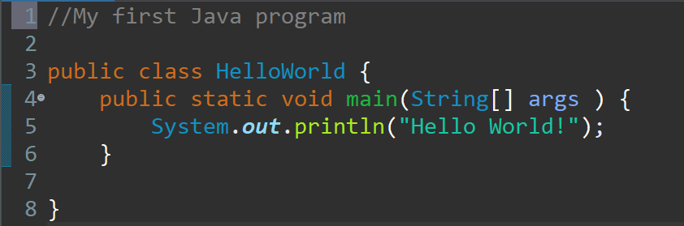
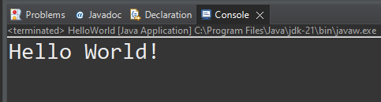
The Parts of a Java Program
When executed, the output appears like this

Slide 14
The Parts of a Java Program
Comment
The // in line 1 marks the beginning of a comment.
The compiler ignores everything from the double slash to the end of the line.
Comments are not required, but comments are very important because they help explain what is going on in the program.

Slide 15
The Parts of a Java Program
Blank Line
Line 2 is blank.
Blank lines are often inserted by the programmer because they can make the program easier to read.

Slide 16
The Parts of a Java Program (cont’d.)
Line 3 is known as a class header, and it marks the beginning of a class definition.
This line of code tells the compiler that a publicly accessible class named HelloWorld is being defined.
A Java program must have at least one class definition.
Class Header

Slide 17
The Parts of a Java Program
Line 3 contains an opening brace, and it is associated with the beginning of the class definition.
The last line in the program, line 8, contains the closing brace.
Everything between the two braces is the body of the class named HelloWorld .
Opening Brace
Class Body
Closing Brace

Slide 18
The Parts of a Java Program
Line 4 is known as a method header, and it marks the beginning of a method.
The name of the method is main, and the rest of the words are required for the method to be properly defined.
Every Java application must have a method named main.
The main method is the starting point of the application.
Method Header

Slide 19
The Parts of a Java Program
Line 4 contains an opening brace that belongs to the main method, and line 6 contains the closing brace.
Everything between the two braces is the body of the main method.
Make sure to have a closing brace for every opening brace in your program.
Opening Brace
Method Body
Closing Brace

Slide 20
The Parts of a Java Program
Line 5 contains a statement that displays a message on the screen.
The group of characters inside the quotation marks is called a string literal.
At the end of the line is a semicolon; it marks the end of a statement in Java.
Not every line of code ends with a semicolon, however.
Statement

Slide 21
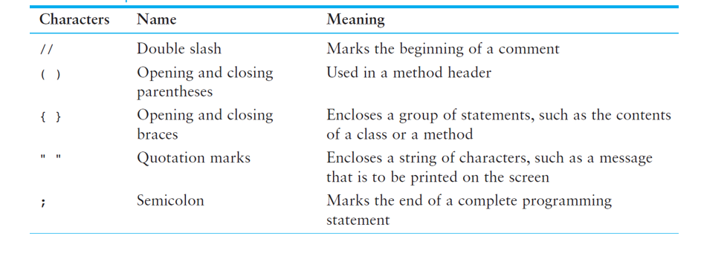
The Parts of a Java Program

Slide 22
The Parts of a Java Program
Java is a case-sensitive language. A ≠ a
All Java programs must be stored in a file with a .java file extension.
Comments are ignored by the compiler.
If a .java file has a public class, the class must have the same name as the file.
Java applications must have a main method.
For every left brace, or opening brace, there must be a corresponding right brace, or closing brace.
Statements are terminated with semicolons, but comments, class headers, method headers, and braces are not.

Slide 23
Find the Bug
** My first Java program
Public Class Displayer (
Public Static void Main(String[] args) {
System.out.print1n(You'll love Java!)
)

Slide 24

The System.out.print and System.out.println Methods
The println method places a newline character at the end of whatever is being printed out.
The following lines:
System.out.println("This is being printed out");
System.out.println("on two separate lines.");
Would be printed out on separate lines since the first statement sends a newline command to the screen.

Slide 25

The System.out.print and System.out.println Methods
The print statement works very similarly to the println statement.
However, the print statement does not put a newline character at the end of the output.
The lines:
System.out.print("These lines will be");
System.out.print("printed on");
System.out.println("the same line.");
Produce the following output: These lines will beprinted onthe same line.
Notice the odd spacing?
Why do some words run together?

Slide 26
The System.out.print and System.out.println Methods
There are some special characters that can be put into the output. System.out.print("This will have a newline.\n");
The \n in the string is an escape sequence that represents the newline character.
Escape sequences allow the programmer to print characters that otherwise would be unprintable.

Slide 27
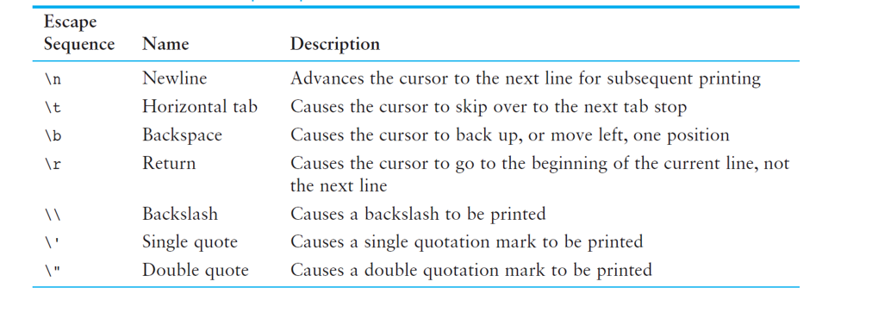
The System.out.print and System.out.println Methods (cont’d.)

Slide 28
The System.out.print and System.out.println Methods (cont’d.)
Even though the escape sequences are comprised of two characters, they are treated by the compiler as a single character.
System.out.print("These are our top sellers:\n");
System.out.print("\tComputer games\n\tCoffee\n ");
System.out.println("\tAspirin");
Would result in the following output:
These are our top sellers:
Computer games
Coffee
Aspirin
With escape sequences, complex text output can be achieved.

Slide 29
End of Module 1

